Slide 1
Architectural Team

Slide 2
Outline
Background and Motivation
Scope of Project
Architectural and Safety System Design
Communication System Design
Power System Design
Future Work and Conclusion
Notes:
Special welcome. To

Slide 3
Background and Motivation
Mars-Oz is a R&D project
Earth based habitat (Arkaroola SA)
Simulating functionality (people and facility)
8 crew members
Waste management, Cabin structure, Power designed by Martian Designs

Slide 4
Scope of Design
Communication System
Communication
Data storage
Architectural and Safety Details
Decks configuration
Safety related designs
Redesign the Power system
Bring down power budget
Bring down cost

Slide 5
Architectural and Safety

Slide 6
MarsDream – Architectural Subgroup
Team Members
Ben Coward – Subsystem Leader
Yilei He – Specialist
Yimeng Jiang – Design Engineer
Yinghua Hu - Specialist
Zhengyi Yao – Design Engineer

Slide 7
MarsDream – Architectural Subgroup
Architectural Tasks
Fire and Safety
Included: fireproofing the decks and stairs, second fire escape, updating fire detection, fire fighting and medical equipment.
Mess Deck Design
Included: ergonomic efficiency in the kitchen and dining area, maximising storage space, adding an upstairs toilet
Flight Deck Design
Included: transformation of area into different room configurations

Slide 8
MarsDream – Architectural Subgroup
Today’s Focus (CORE):
Fireproof Stairs
Mess and Flight Deck – Room Configurations
Briefing and conference
Entertainment
Quiet working
Systems control

Slide 9
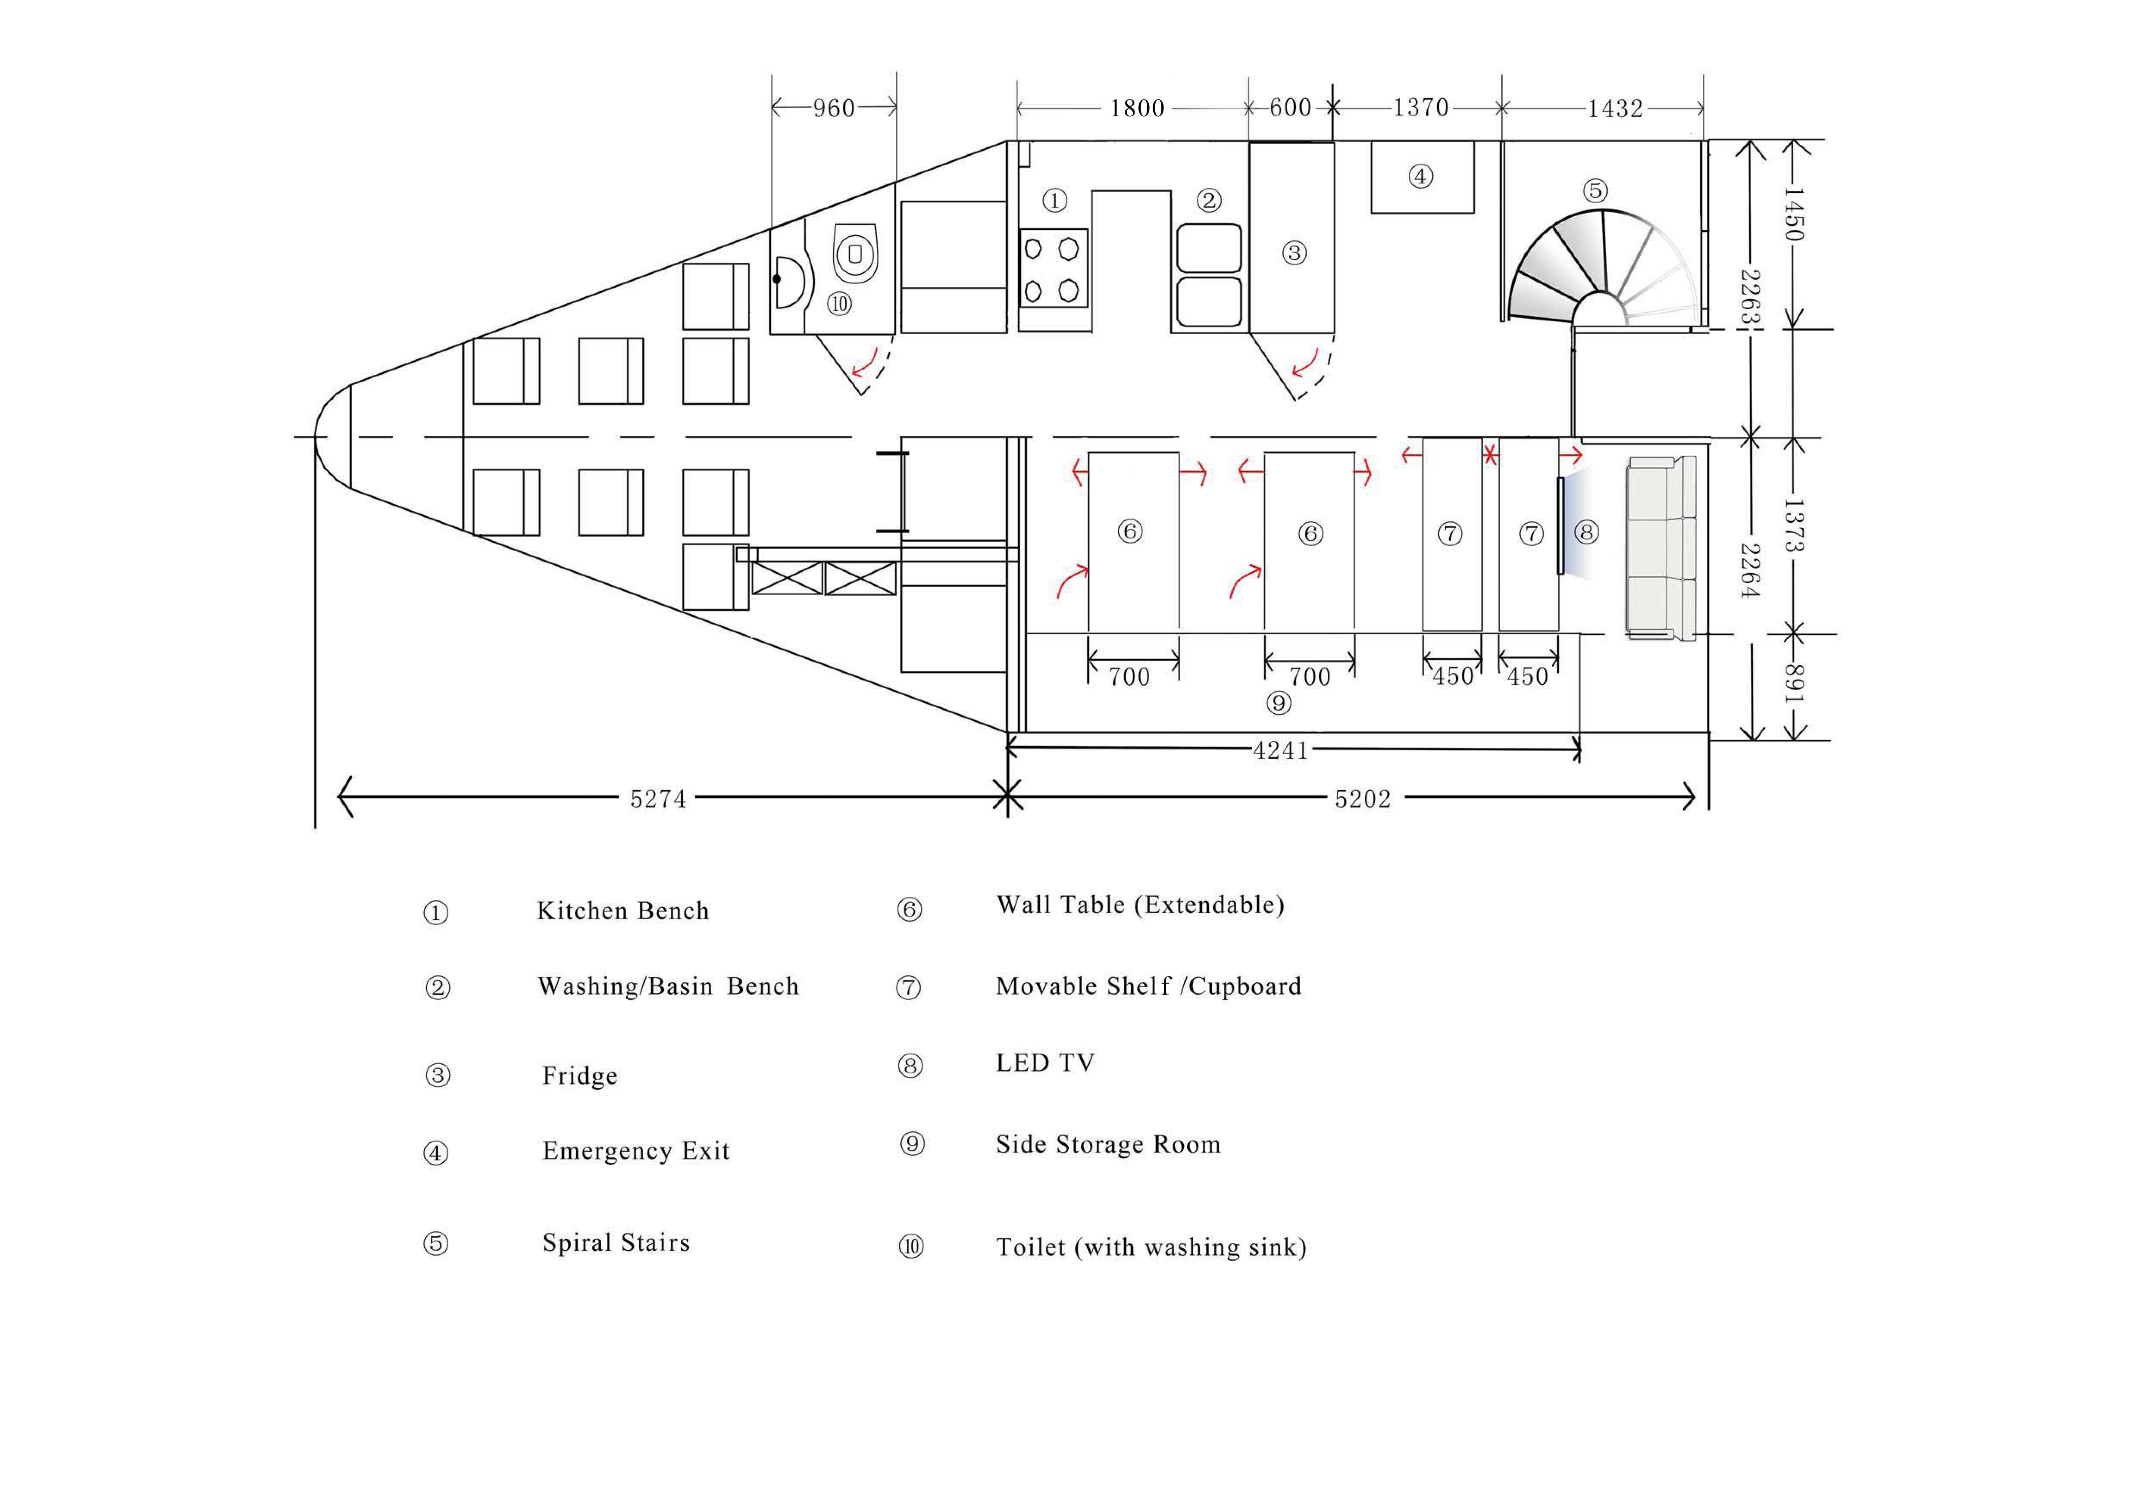
Flight and Mess Deck Room Configurations(Before Landing)

Slide 10
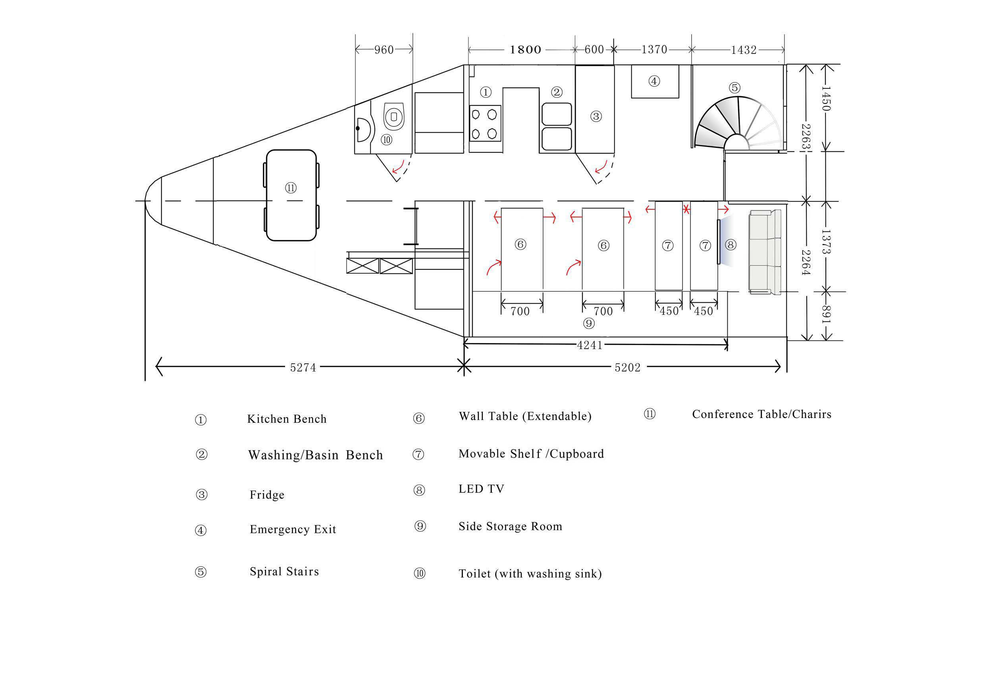
Flight and Mess Deck Room
Configurations(After Landing)

Slide 11
Combined Table and Chairs for Flight Deck

Slide 12
Flight and Mess Deck Room
Configurations(After Landing)

Slide 13
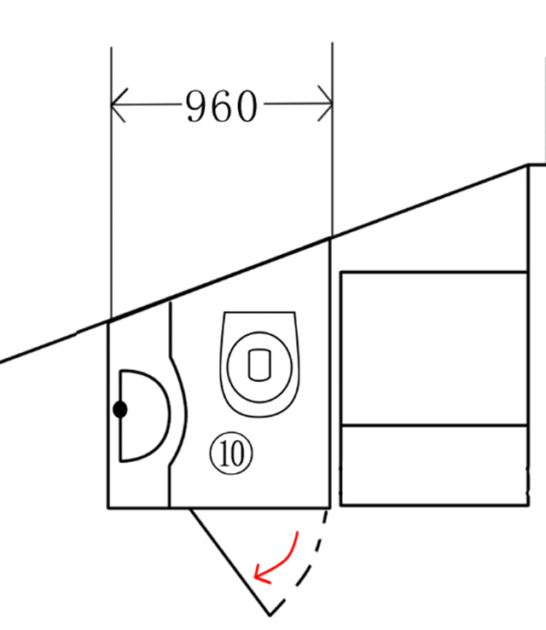
Upper Deck Lavatory
Upper Deck Lavatory
Required for bathroom needs at night
Less than 1m² area
Fully functioning
Incinolet incinerating toilet
Wash basin included

Slide 14
Flight and Mess Deck Room
Configurations(After Landing)

Slide 15
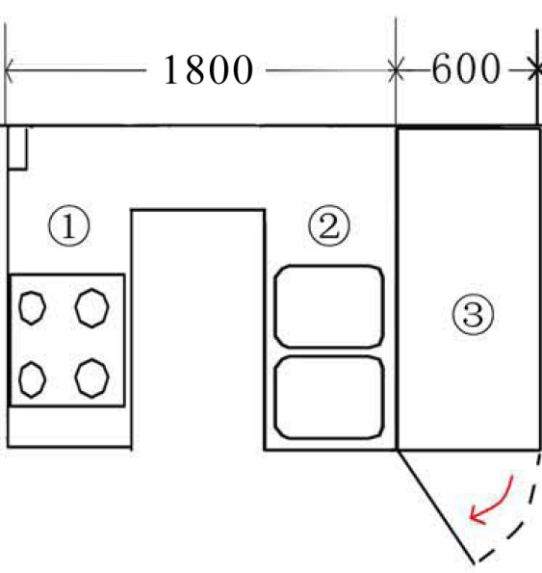
Kitchen
Kitchen
Two big cabinets
One small cabinet
Sink
Refrigerator
Portable induction cooker and microwave

Slide 16
Flight and Mess Deck Room
Configurations(After Landing)

Slide 17
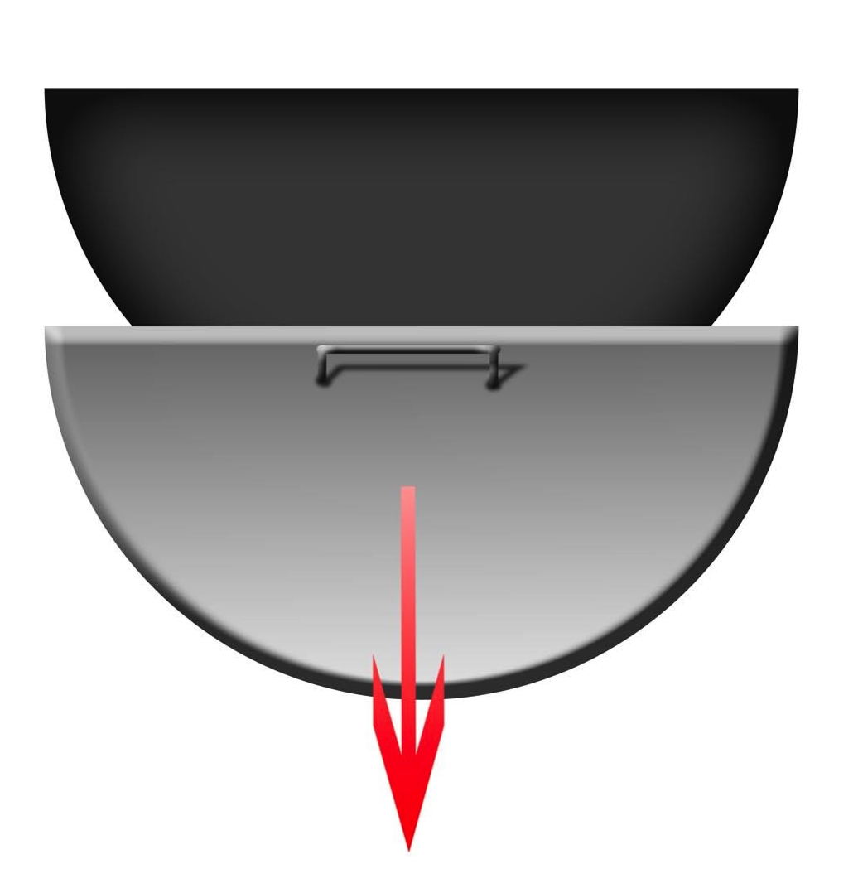
Staircase Design
Fireproof
Material: HPL(Lower Deck) and chemically treated nylon(Upper Deck)
Spiral staircase for saving space
Specification:
270° turning angle, 11 treads, 700mm radius
Sliding lid design (bottom right)

Slide 18
Flight and Mess Deck Room
Configurations(After Landing)

Slide 19
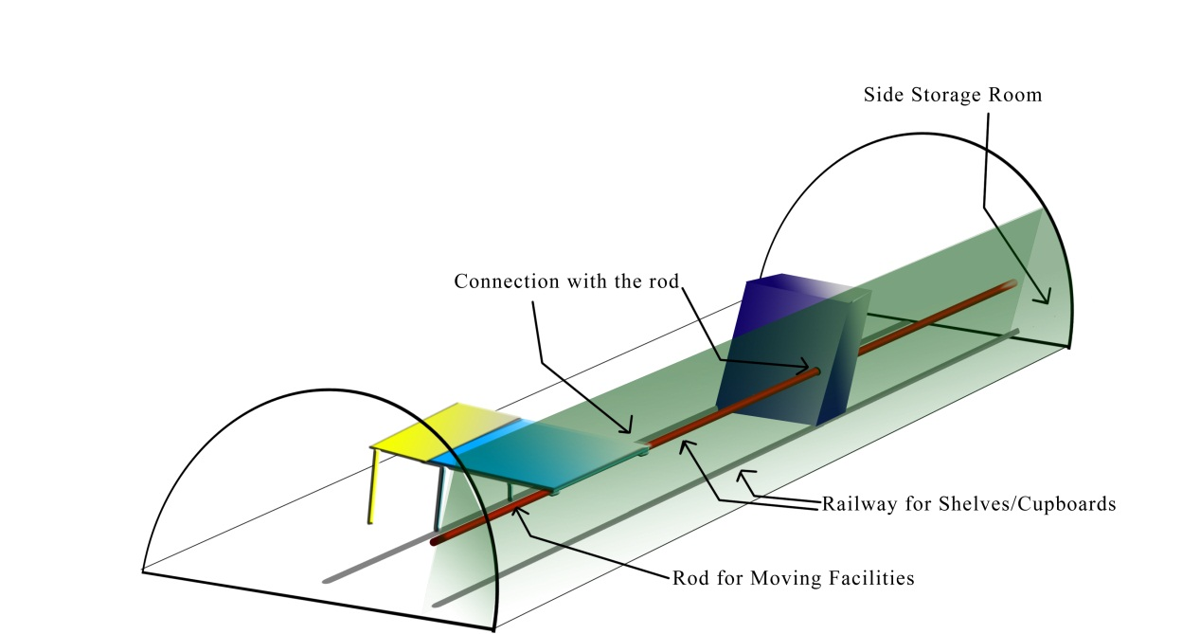
Moving Facilities and Folding Tables Design
Folding Tables, Moving Shelf and Side Storage Design

Slide 20
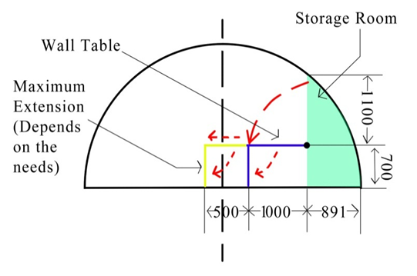
Side Storage Design
Folding Tables and Side Storage
Multiple functions: dining, studying, working and conference
Size: 4.76m³
Strong, light, extendable and detachable

Slide 21
IT & Communication System

Slide 22
IT & Communication System Requirements
Fast Internet access and communication
Outdoor Communication
Data Exchange and Backup

Slide 23
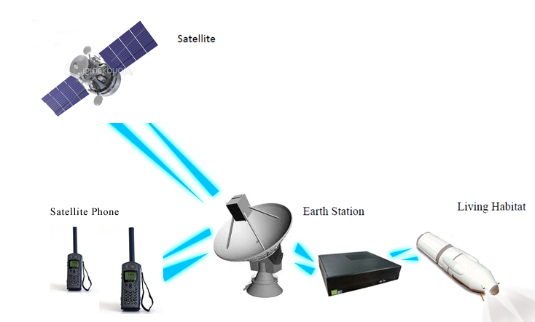
Communication And IT

Slide 24
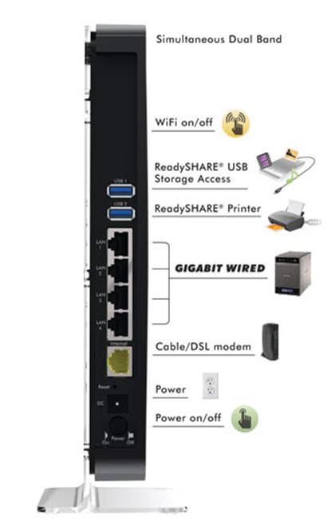
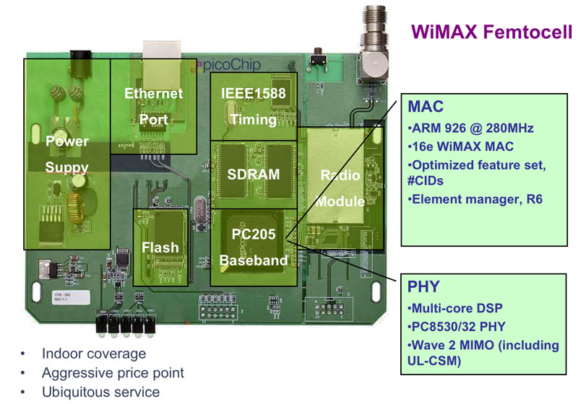
Wireless and Femtocell
NETGEAR N900 Router

Slide 25
Indoor Wireless Communication System— Location Specification
Requirement:
Full Wireless Signal Coverage
Signal to Interference plus Noise Ratio (SINR)
Desirable Value: $≥40$dB
Design Methodology
Major considerations: Path loss, Wall loss …
Simulation Technique: MATLAB ‘Heat Map’

Slide 26
Heat Map Simulation Result for Optimal Location Selection—Lower Floor
Ensures Acceptable Wireless Signals for Whole Floor
Provides Desirable Wireless Signal for Work Area

Slide 27
Heat Map Simulation Result for Optimal Location Selection—Upper Floor
Ensures Acceptable Wireless Signals for Whole Floor
Provides Desirable Wireless Signal in Most Areas

Slide 28
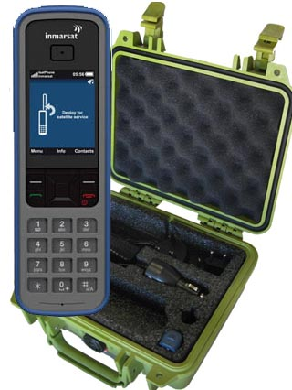
Satellite Phone
 | Inmarsat IsatPhone Pro
Coverage | Global
Size (L x W x D) | 170 x 54 x 39mm
Weight | 279g
Talking time | Up to 8 hours
Standby time | Up to 100 hours

Slide 29
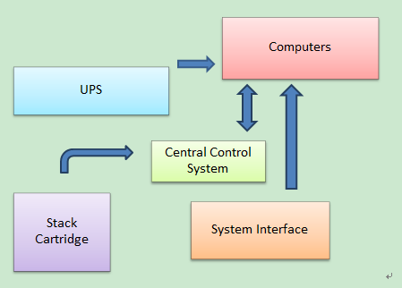
Data Management and Backup

Slide 30
TYBT RS2000 Storage System
Width | 19in/48.3cm
Height | 31in/79cm
Depth | 33in/84cm
Weight | 400lbs/181kg
Maximum Capacity | 100TB (8 TeraStack)
Burners | 6 to 14 Dual layer Blu-ray
Operating Environment | Temperature 10-35 C Humidity 20-80%
Power Usage | 425W
Heat Generation | 2047 BTU per hour
Robotic Sensor Type | Class 2 Laser
COST | 2000 AUD

Slide 31
Central Control System
ms
Operating System | Microsoft Windows Server 2008
Processor | Dual AMD Operon 2214HE 2.0GHz Quad-core
Memory | Optional 16GB DDR2 667MHz ECC RAM
RAID Controller | Areca ARC-1680-ix
Network Interface | Gigabit Ethernet, Fibre compatible with expansion card (10GigE, FC optional)
PCI Expansion | PCI, PCI-X, or PCIe x16, SCSI compatible

Slide 32
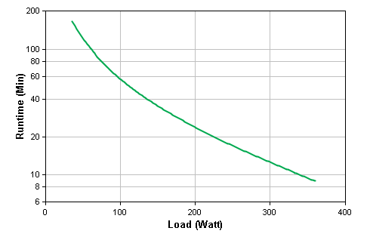
Uninterruptible Power Supply (UPS)
Output Power Capacity | 360 Watts / 500 VA
Max Configurable Power Output Voltage Distortion Output Frequency (sync to mains) | 360 Watts / 500 VA Less than 5% at full load 47 - 53 Hz for 50 Hz nominal,57 - 63 Hz for 60 Hz nominal
Nominal Output Voltage Waveform Type Height | 100V Sine wave 162.00 mm
Width | 140.00 mm
Depth | 358.00 mm
Net Weight | 12.50 KG
COST | 587 AUD

Slide 33
From 254kWh to 64kWh
Power System Design

Slide 34
Air-Con System
Indoor temperature should be 20°C to 25°C during the normal operation.
Indoor temperature should not be higher than 40°C in standby mode.
Energy consumption is limited up to 14kWh per day.

Slide 35
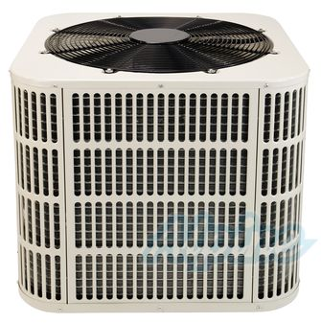
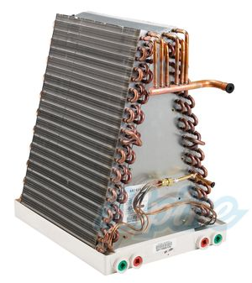
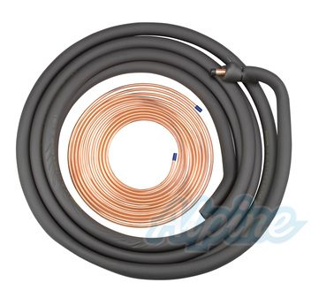
System components
Condenser
Thermostat
Evaporator
Refrigerant line
Air ducts
Air vents
Notes:
Considered many methods. Design methodology

Slide 36
System Layout cont.

Slide 37
System Layout

Slide 38
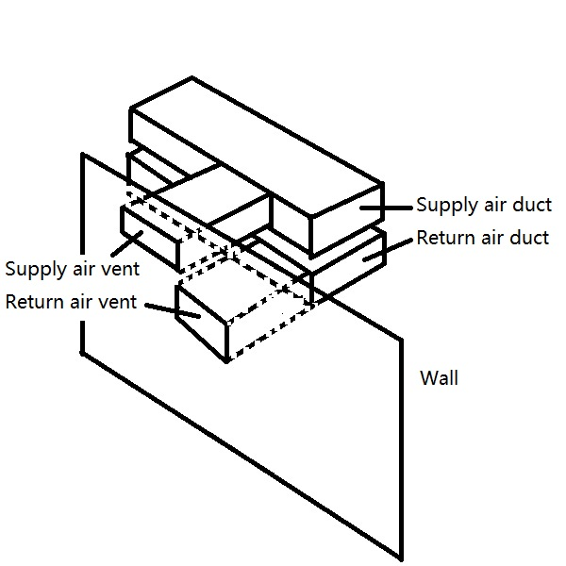
System Layout cont.

Slide 39
Verification
Cooling/heating
Requirement: 3.727 kW for heating, 1.725 kW for cooling
Actual: support cooling/heating of 1.5 tonnes, equivalent to 5.27 kW
Energy consumption
Requirement: Less than 14 kWh/day
Actual: 3.36 kWh/day in standby mode,
13.04 kWh/day in normal operation
Duct sizing
Meet relevant standards
(For more details about verification, see final report)
Notes:
Meets the requirement

Slide 40
System Cost
System Components | Number of unit | Manufacture | Unit price | Total price
Condenser | 1 | Alpine | $778.99 | $778.99
Evaporator | 1 | Alpine | $181.99 | $181.99
Thermostat | 11 | Aprilaire | $163.99 | $1803.89
Refrigerant line | 1 | Alpine | $112.99 | $112.99
Air ducts | 1 | HUAHAI | $1000 | $1000
Supply air vents | 11 | Greenairsys | $30 | $330
Return air vents | 11 | VENTECH | $30 | $330
Total |  |  |  | $4537.86

Slide 41
Power and Lighting
Reduction of energy consumption on electrical appliances including lights, Incinolet, etc.
Provide layout drawing and verification.

Slide 42
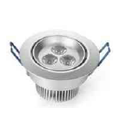
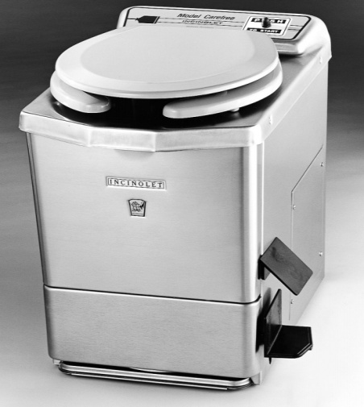
Lights and Incinolet
LED Par 20 5W (Full Spectrum Lighting) for lab, flight deck, dining room and entertainment area.
Seno 3W LED Downlight, Part No.4301 for other rooms
One INCINOLET on each floor
For each one, 2 kWh for each cycle
For each one, 3 cycles per day
Total energy consumption of
the two is 12 kWh per day
Notes:
Psychological issues

Slide 43
Layout of Lights – Lower Floor
Notes:
Compute aided design.

Slide 44
Layout of Lights – Upper Floor

Slide 45
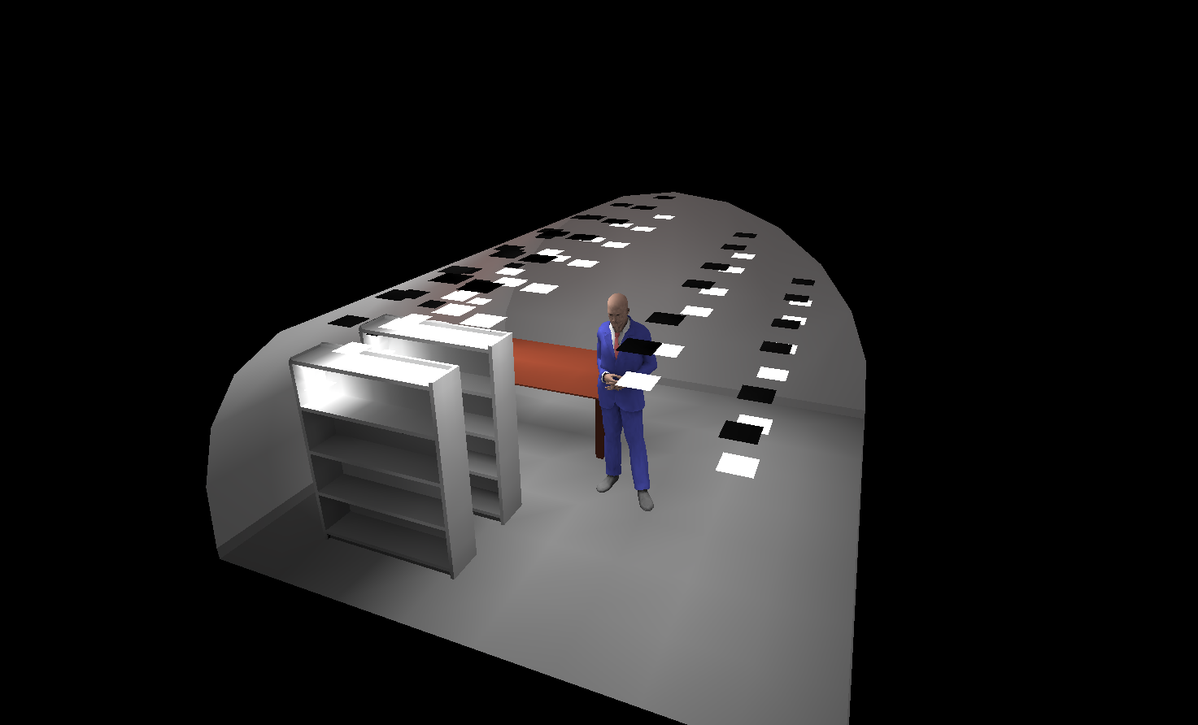
AGI32 Simulation
Notes:
Size verification: compare the dimensions of products and the rooms
Illuminance verification

Slide 46
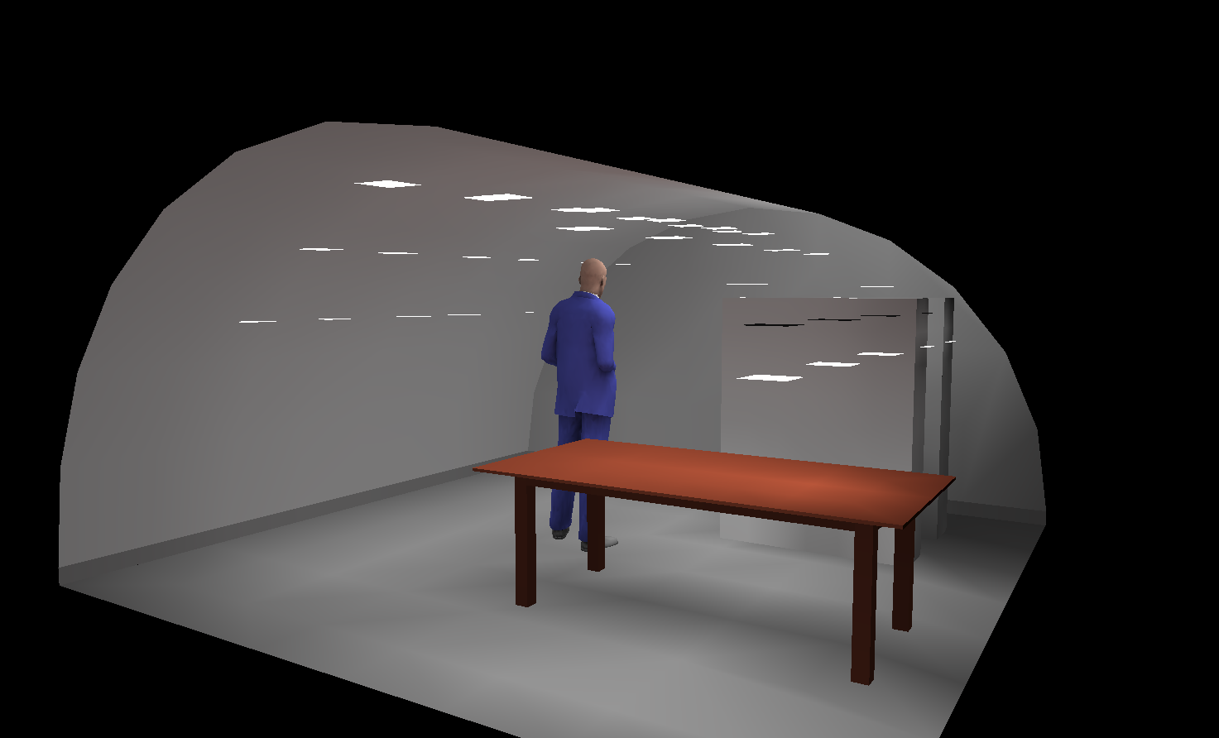
AGI32 cont.

Slide 47
Cost
The total cost (including miscellaneous) is about 29000 AUD.
The cost breakdown is in Table 4-8 of the final report.

Slide 48
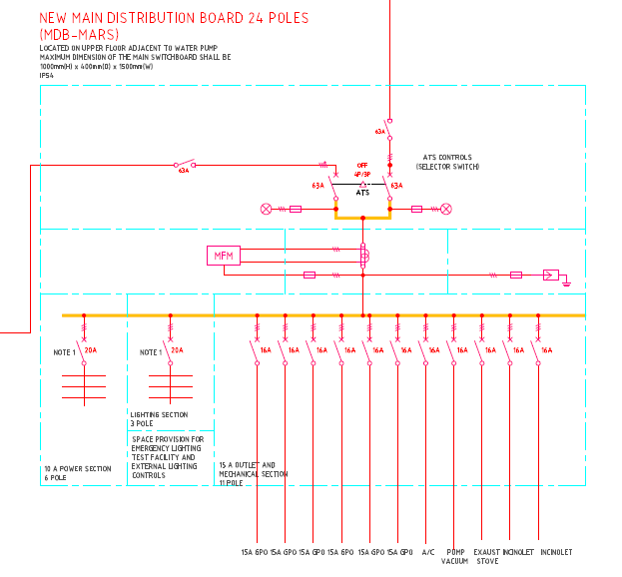
Power Distribution
Solar
Diesel
AS/NZS 3000: Wiring Rule
Notes:
We have also provided maximum demand calculation, voltage drop analysis and provided with entire detailed drawing.

Slide 49
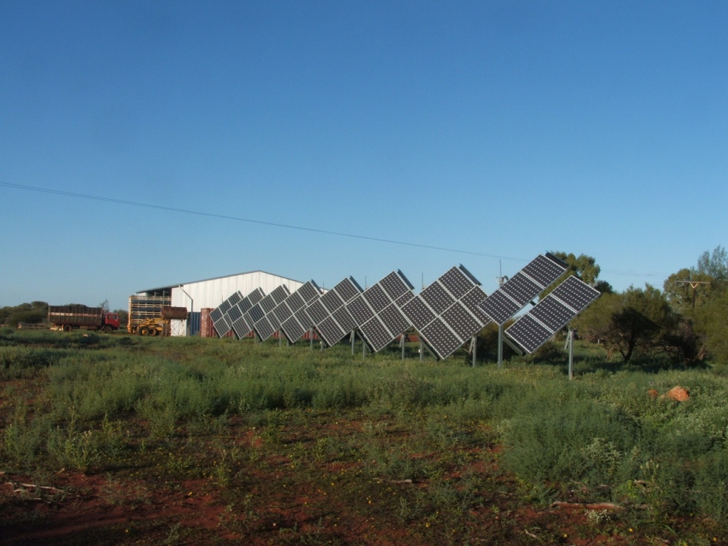
Future Work
Detailed of installation.
Tracking solar panel.
Moving shelves detailed mechanism
Earth Station Design
HUB Server

Slide 50
Thank you!
Special thanks to Jon, Liam, David.
Special thanks to James, Rob, Lyle, etc.
Questions

Slide 51
Reference
Limited, S. L. (., 2012. LED Downlight---No.2 Sheet, 3W-7W EE-SERIES 43 LED DOWNLIGHTS NO.2-SENO 2012.pdf, s.l.: s.n.
Lumiram, 2010. Lumiram. [Online] Available at: http://www.lumiram.com/chromalux-par-led-bulbs/34-led-par-20.html [Accessed 16 May 2012].
NSF, n.d.. INCINOLET Electric Incinerating Toilet Installation / Maintenance Manual. [Online] Available at: http://incinolet.com/incinoletmanualhi.pdf [Accessed 27 May 2012].

Slide 52
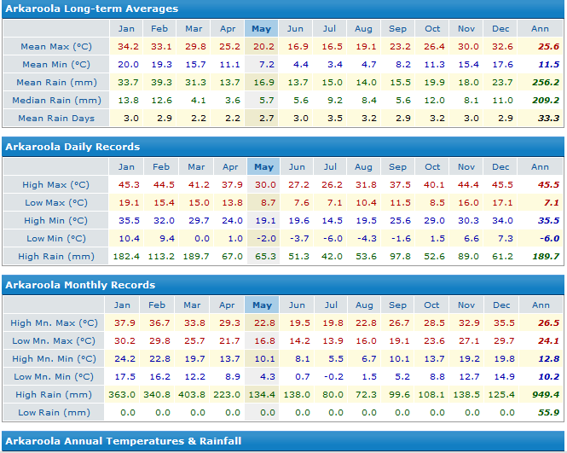

Slide 53
Equation for Signal Coverage
The following equation is about the calculation of received signal power,
$$P_{r}dB=P_{t}dB−PLdB−WLdB+XdB$$
$P_{r}$: Received signal power
$P_{t}$: Transmitted signal power.
$PL$: Path Loss
WL: Wall loss
X: Shadowing, small scale fading and channel noise component (Zero mean logarithmic random distributed).
Pass Loss Model:
ITU P.1238 has the following form: $L_{total}=20\log_{10}{f}+Nlog_{10}d+L_{f}\left(n\right)−28,$

Slide 54
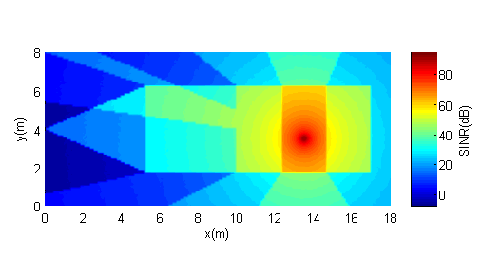
Other Indoor Base Station Location— Lower Floor

Slide 55
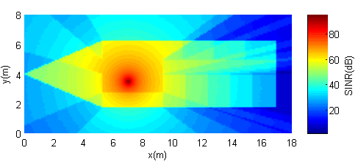
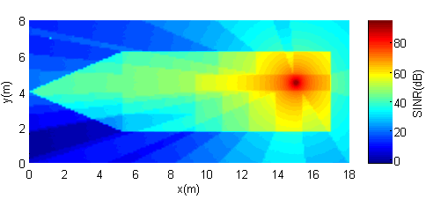
Other Indoor Base Station Location— Upper Floor

